Slide 1
Chapter 2
NUMBER SYSTEM

Slide 2
Topics
2.1 Decimal, Binary, Octal and Hexadecimal Numbers
2.2 Relation between binary number system with other number system

Slide 3
2.3 Representation of integer, character and floating point numbers in binary
2.4 Arithmetic Operations for Ones Complement, Twos Complement, magnitude and sign and floating point number

Slide 4
2.1) Decimal, Binary, Octal and Hexadecimal Numbers
Introduction
Most numbering system use positional notation :
N = a_{n}r^{n} + a_{n-1}r^{n-1} + … + a₁r¹ + a₀r⁰
Where: N: an integer with n+1 digits
a_{i} ∈ {0, 1, 2, … , r-1}
r: base

Slide 5
Example:
a) r = 10 (base 10) => decimal numbers
symbol : 0, 1, 2, 3, 4, 5, 6, 7, 8, 9 (10 different symbols)
N = 278 => n = 2; a₂ = 2; a₁ = 7; a₀ = 8
= (2 x 10²) + (7 x 10¹) + (8 x 10⁰)
Hundreds
Tens
Ones

Slide 6
b) r = 2 (base-2) => binary numbers
symbol: 0, 1 (2 different symbols)
N = 1001₂ => n = 3; a₃ = 1; a₂ = 0; a₁ = 0; a₀ = 1
= (1 x 2³) + (0 x 2²) + (0 x 2¹) + (1 x 2⁰)
c) r = 8 (base-8) => Octal numbers
symbol : 0, 1, 2, 3, 4, 5, 6, 7, (8 different symbols)
N = 263₈ => n = 2; a₂ = 2; a₁ = 6; a₀ = 3
= (2 x 8²) + (6 x 8¹) + (3 x 8⁰)

Slide 7
d) r = 16 (base-16) => Hexadecimal numbers
symbol : 0, 1, 2, 3, 4, 5, 6, 7, 8, 9, A, B, C, D, E, F (16 different symbols)
N = 263₁₆ => n = 2; a₂ = 2; a₁ = 6; a₀ = 3
= (2 x 16²) + (6 x 16¹) + (3 x 16⁰)

Slide 8
Decimal
Binary
Octal
Hexadecimal
0
0
0
0
1
1
1
1
There are also non-positional numbering systems.
Example: Roman Number System
1987 = MCMLXXXVII
2
10
2
2
3
11
3
3
4
100
4
4
5
101
5
5
6
110
6
6
7
111
7
7
8
1000
10
8
9
1001
11
9
10
1010
12
A
11
1011
13
B
12
1100
14
C
13
1101
15
D
14
1110
16
E
15
1111
17
F
16
10000
20
10

Slide 9
2.2) Relation between binary number system and others
2.2.1) Binary and Decimal
  Converting a decimal number into binary
  Integers:
    Divide the decimal number by 2 and take its remainder
    The process is repeated until it produces the result of 0
    The binary number is obtained by taking the remainder from the bottom to the top

Slide 10
Example:
53₁₀ => 53 / 2 = 26 remainder 1
26 / 2 = 13 remainder 0 13 / 2 = 6 remainder 1
6 / 2 = 3 remainder 0 3 / 2 = 1 remainder 1
1 / 2 = 0 remainder 1
⇒ 110101₂ (6 bits) = 00110101₂ (8 bits)
(note: bit = binary digit)
Read the remainders from the bottom to the top

Slide 11
Fractions:
The fraction part in binary notation can be represented by:
  0.b₋₁b₋₂b₋₃….. , where b_{i} = 0 or 1
  and has the value:
  (b₋₁ x 2⁻¹) + (b₋₂ x 2⁻²) + (b₋₃ x 2⁻³) + ….
  Examples:
  0.1011₂ = (0x2⁰)+(1x2⁻¹)+(0x2⁻²)+(1x2⁻³)+(1x2⁻⁴)
  11.011₂ = (1x2¹)+(1x2⁰)+(0x2⁻¹)+(1x2⁻²)+(1x2⁻³)

Slide 12
Decimal to Binary
  multiply the decimal fraction by two and take the value of the integer part.
  use the fraction part of the product as the multiplicand in the step.
  the process is repeated until to the approximate value needed.

Slide 13
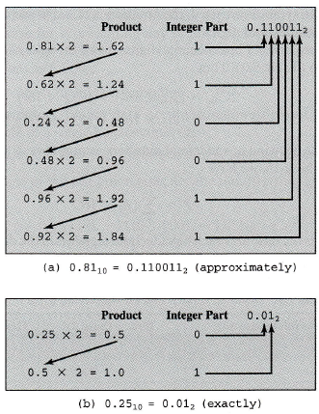
Examples:

Slide 14
2. Converting a binary number into decimal
Integers:
Multiply each bit in the binary number with the weight (or position value)
Add up all the results of the multiplication performed
The desired decimal number is the total of the multiplication results performed

Slide 15
Example:
a) 111001₂ (6 bits)
= (1x2⁵) + (1x2⁴) + (1x2³) + (0x2²) + (0x2¹) + (1x2⁰)
= 32 + 16 + 8 + 0 + 0 + 1
= 57₁₀
b) 00011010₂ (8 bits)
= 2⁴ + 2³ +2¹
= 16 + 8 + 2
= 26₁₀

Slide 16
Fractions:
Note: The steps are similar to the integers.
Example:
  1) 0.1011₂ = (0x2⁰)+(1x2⁻¹)+(0x2⁻²)+(1x2⁻³)+(1x2⁻⁴)
  = 0.0 + 0.5 + 0.25 + 0.125 + 0.0625
  = 0.9375₁₀
  2) 11.011₂ = (1x2¹)+(1x2⁰)+(0x2⁻¹)+(1x2⁻²)+(1x2⁻³)
  = 2 + 1 + 0 + 0.25 + 0.125
  = 3. 375₁₀

Slide 17
2.2.2) Binary and Octal
Theorem
If base R₁ is the integer power of other base, R₂, i.e. R₁ = R₂^{d}
Every group of d digits in R₂ is equivalent to 1 digit in the R₁ base
(Note: This theorem is used to convert binary numbers to octal and hexadecimal or the other way round)

Slide 18
From the above theorem, assume that
R₁ = 8 (base-8) octal
R₂ = 2 (base-2) binary
If R₁ = R₂^{d} ⇒ 8 = 2³
⇒ So, 3 digits in base-2 (binary) is equivalent to 1 digit in base-8 (octal)

Slide 19
From the stated theorem, the following is a binary-octal conversion table.
Binary
Octal
In a computer system, the conversion from binary to octal or otherwise is based on the conversion table above.
000
0
001
1
010
2
011
3
100
4
101
5
110
6
111
7

Slide 20
Example:
Convert the folowing binary numbers into octal numbers:
i) 00101111₂ (8 bits) ii) 11110100₂ (8 bits)
Refer to the binary-octal conversion table above
000 101 111
= 57₈
Refer to the binary-octal conversion table above
11 110 100
= 364₈
0
5
7
3
6
4

Slide 21
b) Convert the following octal numbers into binary numbers (16 bits)
(a) 65₈ (b) 123₈
Refer to the binary-octal conversion table above
6₈ 5₈
110 101
= 0000 0000 00110101₂
Refer to the binary-octal conversion table above
1₈ 2₈ 3₈
001 010 011
= 0000000001010011₂

Slide 22
2.2.3) Binary and Hexadecimal
The same method that employed in binary-octal conversion is used.
Assume that:
R₁ = 16 (hexadecimal)
R₂ = 2 (binary)
⇒ from the theorem: 16 = 2⁴ , hence, 4 digits in a binary number is equivalent to 1 digit in the hexadecimal number system (and otherwise)

Slide 23
Binary
Hexadecimal
0000
0
Example:
Convert the binary number, 00101111₂ into hexadecimal number.
Refer to the binary-hexadecimal conversion table:
0010 1111₂ = 2F₁₆
2 F
0001
1
0010
2
0011
3
0100
4
0101
5
0110
6
0111
7
1000
8
1001
9
1010
A
1011
B
1100
C
1101
D
1110
E
1111
F

Slide 24
b) Convert the following hexadecimal numbers into binary numbers
(a) 12B₁₆ (b) ABCD₁₆
Refer to the binary-hexadecimal conversion table above
1 2 B₁₆
0001 0010 1011₂
= 000100101011₂
Refer to the binary-hexadecimal conversion table above
A B C D₁₆
1010 1011 1101 1110₂
= 1010101111011110₂

Slide 25
2.3) Representation of integer, character and floating point numbers in binary
2.3.1) Introduction
Machine instructions operate on binary data. The most important general categories of data are:
1. Addresses – unsigned integer
2. Numbers – integer or fixed point, floating point numbers and decimal (eg, BCD (Binary Coded Decimal))

Slide 26
3. Characters – IRA (International Reference Alphabet), EBCDIC (Extended Binary Coded Decimal Interchange Code), ASCII (American Standard Code for Information Interchange)
4. Logical Data – only has 2 values either 1 or 0.
Those commonly used by computer users/programmers: signed integer, floating point numbers and characters

Slide 27

ASCII Code

Slide 28
2.3.2) Signed Integer Representation
Signed integers are usually used by programmers
Unsigned integers are used for addressing purposes in the computer (especially for assembly language programmers)
Three representations of signed integers:
  1. Sign-and-Magnitude
  2. Ones Complement
  3. Twos Complement

Slide 29
a) Sign-and-Magnitude
The easiest representation
The leftmost bit in the binary number represents the sign of the number, 0 if positive and 1 if negative
The balance bits represent the magnitude of the number.

Slide 30
Examples:
i) 8 bits binary number
__ __ __ __ __ __ __ __
7 bits for magnitude (value)
a) (i) +7 = 0 0 0 0 0 1 1 1
Sign bit
0 => +ve
1 => –ve
Magnitude for 7₁₀ in 7-bit binary
Sign bit = 0 (+ve number)

Slide 31
(ii) –7 = 10000111₂
Magnitude for 7₁₀ in 7-bit binary
Sign bit = 1 (-ve number)
b) (i) –10 = 1 0 0 0 1 0 1 0
(ii) +10 = 00001010₂
Magnitude for 10₁₀ in 7-bit binary
Magnitude for 10₁₀ in 7-bit binary
Sign bit = 1 (-ve number)
Sign bit = 0 (+ve number)

Slide 32
ii) 6 bits binary number
__ __ __ __ __ __
5 bits for magnitude (value)
a) (i) +7 = 0 0 0 1 1 1 (ii) -7 = 1 0 0 1 1 1
Sign bit
0 => +ve
1 => –ve
Magnitude for 7₁₀ in 5-bit binary
Magnitude for 7₁₀ in 5-bit binary
Sign bit = 0 (+ve number)
Sign bit = 0 (+ve number)

Slide 33
b) Ones Complement
In the ones complement representation, positive numbers are same as that of sign-and-magnitude
Example: +5 = 00000101 (8 bit)
⇒ as in sign-and-magnitude representation
Sign-and-magnitude and ones complement use the same representation for all positive numbers.
Sign bit = 0 (+ve number)
Magnitude for 5₁₀ in 7-bit binary

Slide 34
⇒ For negative numbers, their representations are obtained by changing bit 0 → 1 and 1 → 0 from their positive number representations.
Example: Convert –5 into 8-bit ones complement representation.
Solution:
First, obtain +5 representation in 8 bits
⇒ 00000101
Change every bit in the number from 0 to 1 and
vice-versa.
–5₁₀ in ones complement is 11111010₂

Slide 35
Exercise:
Get the representation of ones complement (6 bit) for the following numbers:
i) +7₁₀ ii) –10₁₀
Solution:
(+7) = 000111₂
Solution:
+10₁₀ = 0 0 1 0 1 0₂
So, -10₁₀ = 1 1 0 1 0 1₂
Magnitude for 7₁₀ in 5-bit binary
Sign bit = 0 (+ve number)
Change each bit 0 → 1 and 1 → 0

Slide 36
c) Twos complement
For +ve numbers  their representations are similar to ones complement and sign-and-magnitude
For –ve numbers  their representations are obtained by adding 1 to the ones complement of the numbers.

Slide 37
Example:
Convert –5 into twos complement representation and give the answer in 8 bits.
Solution:
❖ First, obtain +5 representation in 8 bits
⇒ 00000101₂
❖ Obtain ones complement for –5
⇒ 11111010₂
❖ Add 1 to the ones complement number:
⇒ 11111010₂ + 1₂ = 11111011₂
❖ –5 in twos complement is 11111011₂

Slide 38
Exercise:
What are the representations of the following numbers in 6-bit twos complement?
i) +7₁₀ ii) –10₁₀
Solution:
+7 = 000111₂
Solution:
+10₁₀ = 001010₂
-10₁₀ = 110101₂ + 1₂
= 110110₂
So, twos complement for –10 is 110110₂
-10₁₀ in ones complement

Slide 39
2.3.3) Character Representation
For character data type, its representation uses codes such as the ASCII, IRA or EBCDIC.
Note: Students are encouraged to obtain
the codes

Slide 40
2.3.4) Floating point representation
In computer, floating point numbers are represented in the form of:
+S x B^{+E}
and the number can be stored in computer words with 3 fields:
  i) Sign (+ve, –ve)
  ii) Significand S
  iii) Exponent E
where B is base and is implicit (need not be stored because it is the same for all numbers (base-2)).

Slide 41
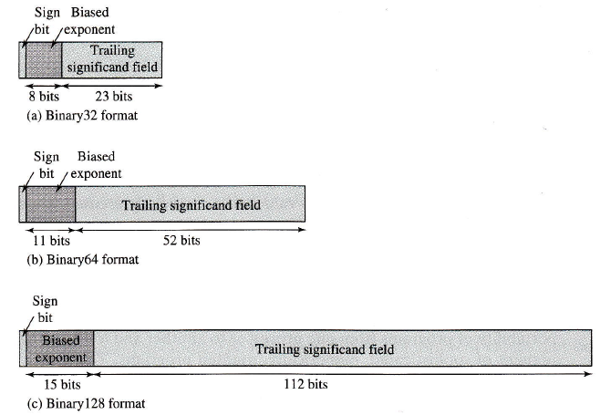
Diagrams below are IEEE standard for binary floating-point known as IEEE Standard 754.

Slide 42
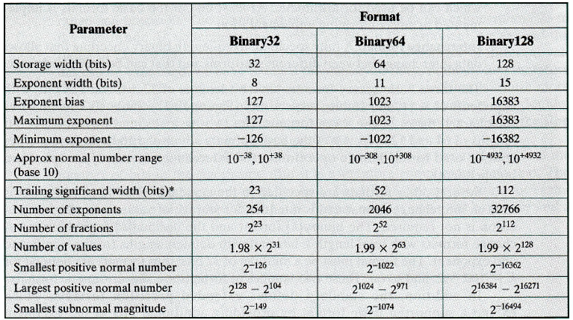
The characteristics of the three formats:

Slide 43
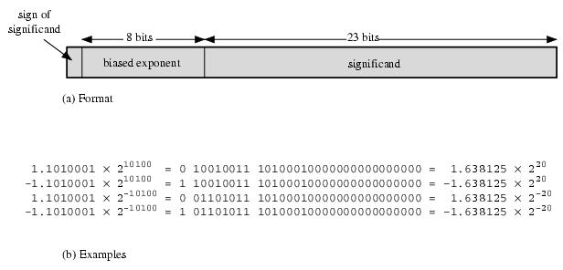
Below are examples of floating-point number with 8 bits for biased exponent (Binary32).

Slide 44
Biased Exponent
  In IEEE 754 floating points numbers, the exponent is biased – the value stored is offset from the actual value by the exponent bias.
  To calculate the bias for an arbitrary sized floating point number apply the formula 2^{(k-1)} -1 where k is the number of bits allocated for an exponent field.
  If k=8, the bias is 2⁸⁻¹ - 1 = 128 - 1 = 127₁₀ = 1111111₂
    Eg1: 1.1010001 x 2¹⁰¹⁰⁰
    An exponent 10100₂ will convert to the biased exponent 10010011₂ (1111111₂ + 10100₂)

Slide 45
2.4) Arithmetic Operations for Ones Complement, Twos Complement, and sign-and-magnitude.
6.4.1) Introduction
Reminder: This chapter only focus on addition and subtraction only.
Most of the computer system will change the subtraction operation to the addition operation
Example: i) 8 – 5 = 8 + (–5)
ii) –10 + 2 = (–10) + 2
iii) 6 – (–3) = 6 + 3

Slide 46
2.4.2) Sign-and-Magnitude
Assume that the operation is:
Z = X + Y
There are a few possibilities:
i) If both numbers, X and Y are positive
⇒ Just perform the addition operation
Example: 5₁₀ + 3₁₀ = 000101₂ + 000011₂
= 001000₂
= 8₁₀

Slide 47
ii) If both numbers are negatives
⇒ Add |X| and |Y| and set the sign bit = 1 to the result, Z
Example:
–3₁₀ – 4₁₀ = (–3) + (–4)
= 100011₂ + 100100₂
☺Only add the magnitude:
00011₂ + 00100₂ = 00111₂
Set the sign bit of the result (Z) to 1 (–ve)
= 100111₂
= –7₁₀

Slide 48
iii) If signs of both numbers are differ
There will be 2 cases:
a) | +ve Number | > | –ve Number |
Example: (–2) + (+4), (+5) + (–3)
⇨ Set the sign bit of the –ve number to 0 (+ve), so that both numbers become +ve.
⇨ Subtract the number of smaller magnitude from the number with a bigger magnitude

Slide 49
Sample solution (in 6-bit):
(–2) + (+4)
⇒ Get the representation for each number:
(–2) = 100010₂
(+4) = 000100₂
⇒ Change the sign bit of the –ve number to +ve
(–2) change to (+2) = 000010₂
⇒ Subtract (+2) from (+4)
= (+4) – (+2)
= 000100₂ – 000010₂
= 000010₂ = 2₁₀

Slide 50
b) | –ve Number | > | +ve Number |
⇨ For this condition, just subtract the +ve number from the –ve number.
Example: (+3₁₀) + (–5₁₀)
⇨ Find the representation for each number
 +3₁₀ = 000011₂
–5₁₀ = 100101₂
⇨ Subtract the +ve number (+3) from the –ve number (-5)
(-5₁₀) - (+3₁₀) = 100101₂ – 000011₂
= 100010₂
= –2₁₀

Slide 51
2.4.3. Ones complement
In ones complement, it is easier than sign-and-magnitude:
⇨ Change the numbers into their representations and perform the addition operation
⇨ However a situation called Overflow might occurs when addition is performed on the following conditions:
1. If both are negative numbers
2. If both numbers are in difference sign and |+ve Number| > | –ve Number|

Slide 52
Overflow => the addition result exceeds the number of bits that was fixed
Condition 1: Both are –ve numbers
Eg: –3₁₀ – 4₁₀ = (–3₁₀) + (–4₁₀)
Solution: (8 bits)
⇨ Convert –3₁₀ and –4₁₀ into ones complement representations.
+3₁₀ = 00000011₂
–3₁₀ = 11111100₂
+4₁₀ = 00000100₂
–4₁₀ = 11111011₂

Slide 53
⇨ Perform the addition operation
–3₁₀ => 11111100₂ (8 bit)
+ – 4₁₀ => 11111011₂ (8 bit)
–7₁₀ 111110111₂ (9 bit)
Overflow occurs. This value is called EAC bit and needs to be added to the rightmost bit.
11110111₂
+ 1₂
11111000₂ = –7₁₀
the answer (8 bits)

Slide 54
Condition 2: | +ve Number| > |–ve Number|
Eg: (–2) + 4 = (–2) + (+4)
Solution: (8 bits)
⇨ Convert –2₁₀ and +4₁₀ into ones complement representation
–2 = 11111101₂ +4 = 00000100₂

⇨ Add both of the numbers
(–2₁₀) => 11111101 (8 bit)
+ (+4₁₀) => 00000100 (8 bit)
+2₁₀ 100000001 (9 bit)
There is an EAC (overflow occurs)

Slide 55
⇨ Add the EAC to the rightmost bit
00000001
+ 1
00000010₂ = +2₁₀
the answer
Note:
⇒ For conditions other than 1 & 2 above, overflow does not occur and there will be no EAC (hence, no need to perform addition operation to the rightmost bit).

Slide 56
2.4.4. Twos Complement
Addition operation in twos complement is same with that of ones complement, i.e. overflow occurs if:
    If both are negative numbers
    If both numbers are in difference sign and |+ve Number| > |–ve Number|

Slide 57
Condition 1: Both numbers are –ve
Example: –3₁₀ – 4₁₀ = (–3₁₀) + (–4₁₀)
Solution: (6 bits)
⇨ Convert both numbers into twos complement representation
+3₁₀ = 000011₂ (6 bit)
–3₁₀ = 111100₂ (one’s complement)
–3₁₀ = 111101₂ (two’s complement)
+4₁₀ = 000100₂
–4₁₀ = 111011₂ (one’s complement)
–4₁₀ = 111100₂ (two’s complement)

Slide 58
⇨Perform addition operation on both the numbers in twos complement representation and ignore the EAC bit.
111100 (–3₁₀)
111011 (–4₁₀)
= 111001₂ (two’s complement)
= –7₁₀
1111001
Ignore the EAC bit
The answer

Slide 59
Note:
In twos complement, EAC is ignored (no need to be added to the leftmost bit, like that of ones complement)

Slide 60
Condition 2: | +ve Number| > |–ve Number|
Example: (–2) + 4 = (–2) + (+4)
Solution:
⇨ Convert both numbers into twos complement representation:
+2 = 000010₂ +4 = 000100₂
–2 = 111101₂ (in ones complement)
–2 = 111101₂ + 1₂
–2 = 111110₂ (in twos complement)

Slide 61
⇨ Perform an addition operation on both numbers:
(–2₁₀) => 111110 (6 bit)
+ (+4₁₀) => 000100 (6 bit)
+2₁₀ 1000010
Ignore the EAC
The answer is 000010₂ = +2₁₀

Slide 62
Note: For cases other than condition 1 and 2 above, overflow does not occur.
Exercise:
Perform the following arithmetic operations in ones complement and twos complement.
1. (+2) + (+3) [6 bit]
2. (–2) + (–3) [6 bit]
3. (–2) + (+3) [6 bit]
4. (+2) + (–3) [6 bit]
Compare your answers with the stated theory.

